Slide 1
DRAFT AWP&B
Mid Day Meal Scheme in SIKKim:
2014-15
SIKKIM
ANNUAL WORK PLAN & BUDGET
2020-21
MID-DAY MEAL SCHEME

Slide 2
ADMINISTRATIVE HIERARCHY OF MDM SCHEME.
State Project Office (director)
District Project Office (jt. Director]
block Level (Asst. Director).
School Level (HoIs).

Slide 3
NUMBER OF INSTITUTIONs COVERED UNDER MDM
Category | GOVT. | MONAS | SANS | TOTAL
PRY | 390 | 85 | 10 | 485
UP-PRY | 376 | 01 | 06 | 383
TOTAL | 766 | 86 | 16 | 868

Slide 4
Kitchen cum Store
Year-wise details of sanctioned:-
Fin. Year | No. of units sanctioned | Central Assistance released [Rs. In lakh] | State Share | Remarks
2006-07 | 245 | 147.00 | 0
 | 555 | 333.00 | 155.00
2008-09 | 59 | 35.40 | 16.52
2013-14 | 77 | 168.94 | 16.90
2018-19 | 12 | 26.39 | 2.93
Total | 948 | 710.73 | 191.35 | All completed

Slide 5
Details of Kitchen Devices: till 2019-20
Fin. Year | Nos. of Units sanctioned | Central assistance released. [Rs. In lakh] |  | Remarks
2006-07 | 446 | 22.32 |  | Utilized
2007-08 | 336 | 16.80 |  | --nil--
2011-12 | 97 | 4.85 |  | --nil--
Total | 879 | 43.97 |  | --nil--
Replacement
2012-13 | 332 | 16.60 | --nil--
 | 111 | 5.55 | --nil--
2013-14 | 336 | 16.80 | --nil--
2018-19 | 540 | 27.00 | --nil--
Total | 1319 | 65.95 | --nil--

Slide 6
ENTITLEMENT OF COOKING COST, 2019-20
CATEGORY | CENTRAL Child/day | STATE [child/day] | TOTAL Child/day
PRIMARY | 4.03 | 0.45 | [4.48]
UPPER PRIMARY | 6.04 | 0.67 | [6.71]

Slide 7
Foodgrains allocation, lifted & Payment thereof: 2019-20
CATEGORY | ALLOCATION [in MTs] | LIFTED in MTS. [upto 3rd Qtr] | Payment to FCI [Rs. In lakh] | Foodgrain Due for 4th Qtr. [in MTs]
PRY | 674.27 | 537.76 | 16.13 | 136.51
UP-PRY | 828.22 | 670.20 | 20.11 | 158.02
TOTAL | 1502.49 | 1207.96 | 36.24 | 294.53

Slide 8
DISTRICT-WISE PERFORMANCE IN Primary. 2019-20
 | Primary [I-V] |  |  | Performance against PAB 2018-19 [%] | Performance against PAB 2019-20 [%]
DISTT | PAB [approved] | Enrol [as on Sept. 19] | Diff [%]
EAST | 11605 | 12855 | +10.77% | 90% | 83.77%
WEST | 7258 | 7862 | +8.32% | 96% | 89.97%
NORTH | 2442 | 2361 | -3.43% | 96% | 92.86%
SOUTH | 8269 | 8537 | +3.24% | 99% | 90.45%
TOTAL | 29574 | 31615 | +6.90% | 94% | 87.80%

Slide 9
District-wise Performance in Up-Pry: 2019-20
 | Upper Pry [VI-VIII] |  |  | Performance during against PAB: 2018-19 | Performance during against PAB: 2019-20
Distt | PAB [Approved] | Enrol [as on Sept,18] | Diff [%]
EAST | 9979 | 10344 | +3.53% | 91% | 82%
WEST | 6219 | 6222 | +0.05% | 88% | 90%
NORTH | 1593 | 1389 | -12.81% | 90% | 95%
SOUTH | 6426 | 6335 | -1.42% | 94% | 91.17%
TOTAL | 24217 | 24290 | +0.30% | 91% | 86.98%

Slide 10
Details of Central and State share received during:- 2019-20
Particulars | Centre Share [Rs. In lakh.] | State Share [Rs. In lakh] | TOTAL [Rs. In lakh] | Exp. of CSS [Rs. In lakh] | Balance of CSS [as on DEC, 19] [Rs. In lakh]
Cost of food-grain | 45.08 | 00 | 45.08 | 36.24 | 8.84
Cooking cost | 605.23 | 51.09 | 656.32 | 363.89 | 292.43
HCCH | 170.19 | 18.91 | 189.00 | 131.26 | 57.74
Transportation Cost | 27.34 | 0 | 27.34 | 21.98 | 5.36
MME | 22.89 | 0 | 22.89 | 11.74 | 11.15
Total | 870.73 | 70.00 | 940.63 | 565.11 | 375.52

Slide 11
NEW INITIATIVES:-
Payment of cooking cost & Honorarium to cook through RTGS to schools a/c.
Sensitizing of MDM scheme at every level.
Centralized payment of FCI.
Training of Cooks cum Helpers at district level by master cooks.
Training to MIS coordinators at districts level to enhance the output

Slide 12
Best Practices:-
Many schools are growing organic vegetables from their school Nutrition Garden.
Schools in rural areas are serving organic vegetables in mid-day meal from the school’s nutrition garden.
Schools are developing Nutrition Garden in their school premises.
Eggs, Fruits & Meats are also being provided during mid-day meal in schools.
Frequent sensitization of hand wash by school teachers.
Multi-tap facilities in schools are being provided by local agencies.
Time to time interaction with students representative about the quality of meals.
Cooking agencies PTA/SMCs are actively involved in serving MDM in the schools.
Grievance Redressal Mechanism.
Involvement of mothers of children in supervision of cooking of mid-day meal.

Slide 13
State Contigency/Emergency Plan:
All officers, school heads, cooking agencies etc are being sensitized on safety measures viz:-
Disaster Management.
Combating fire incidents.
First Aid applications.
Immediate information.
School heads are directed to seek immediate help from Block level officers, Fire Deptt, Police Station, Panchayats, PTA with their respective Phone/Mob. No. provided.
Teaching & Non Teaching staff are sensitizing children on safety measures to deal any kinds of emergency situation.

Slide 14
Proposal for
2020-21

Slide 15
Proposal for 2020-21
No. of Schools:
Primary : 485
Upper Pry : 383
Total : 868
No. of Enrolment:
Primary : 27944
Upper Pry : 22039
Total : 49,983
No. of Cook cum Helpers:
Primary/Upper Pry : 1891
REQUIREMENTOF FOODGRAINS
598.01+707.46:1305.47MTs
Working Days : 214 Days

Slide 16
Proposal for central assistant [2020-21] Recurring.
Components | PRY | Up-PRY | TOTAL [Rs. In lakh]
Foodgrains | 17.94 | 21.22 | 39.16
Cooking Cost | 267.31 | 316.00 | 583.31
HCCH | 107.46 | 62.73 | 170.19
Transportation | 10.88 | 12.88 | 23.76
MME | 10.90 | 11.15 | 22.04
 | TOTAL |  | 838.46
Repair of kitchen shed] | [ for 245 units] | 22.05 | 22.05
Nutrition Garden [247 units] | @ Rs.5000/- | 11.12 | 11.12
Grant TOTAL |  |  | 871.63

Slide 17
Proposal for summer vacations
Summer vacation: 06 days.
Nos. of children: Pry:31615
Up-Pry:24290
Total:-55905
Requirement of foodgrains: 40.83 MTs
Cooking cost :Rs. 18.24 lakh
Cost of foodgrains :Rs. 1.23 lakh
Transportation cost: Rs. 0.74 lakh
TOTAL: Rs. 20.21 lakh

Slide 18
PROBLEMS & ISSUES.
Honorarium of CCH needs to be increased from the present level of Rs. 1000/* to at least Rs.2000 per month.
Central assistance for repair of kitchen sheds @1ok is very meagre due to hilly terrain and high cost of living which need to be revised.
Existing transportation cost @182/- per quintal from FCI to schools is very meagre which needs to be enhanced at flat rate of 400/qtl atleast to deliver foodgrain to door to door of the schools as per the norms.

Slide 19
GLIMPSES OF BEST PRACTICES IN SIKKIM [mid-day meal]

Slide 20
NUTRITION GARDEN

Slide 21
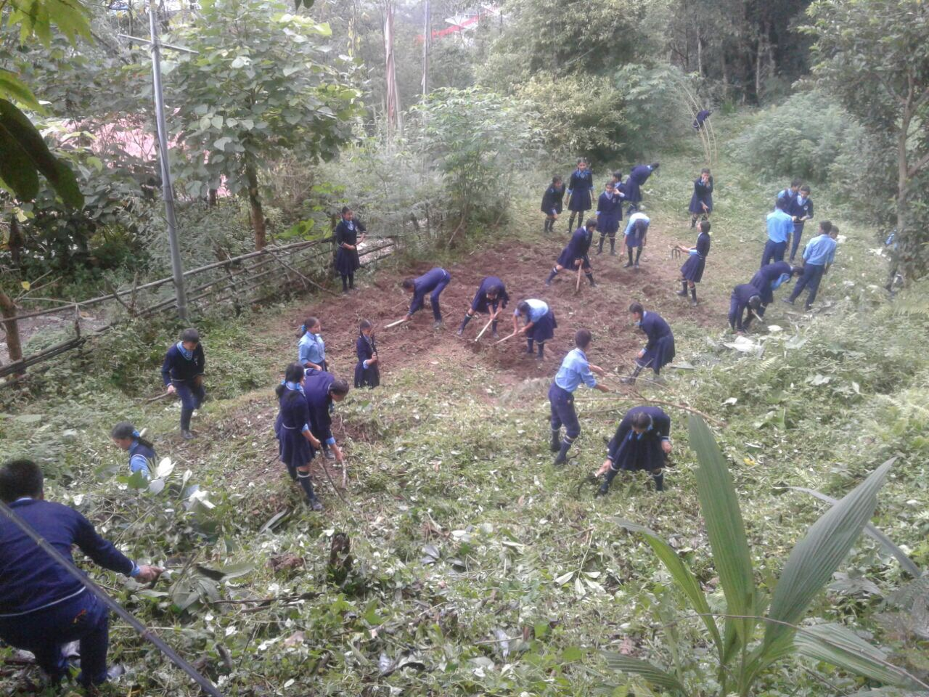
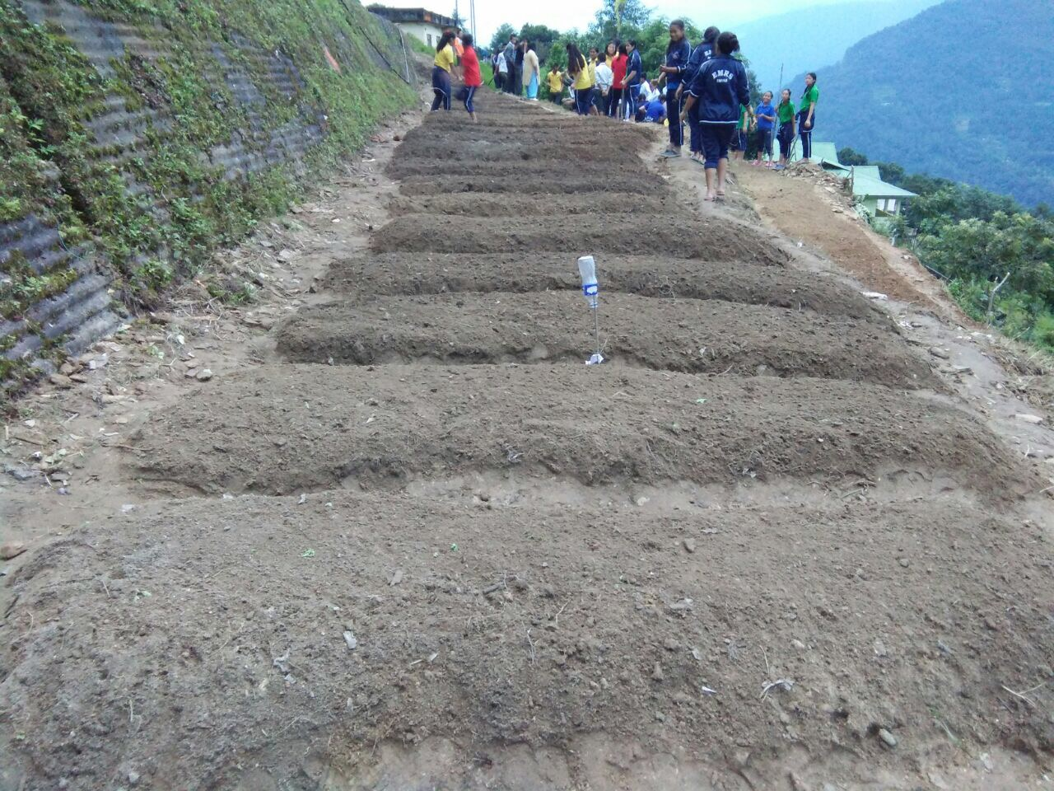
Preparing nursery bed for Organic saplings by students at schools.

Slide 22
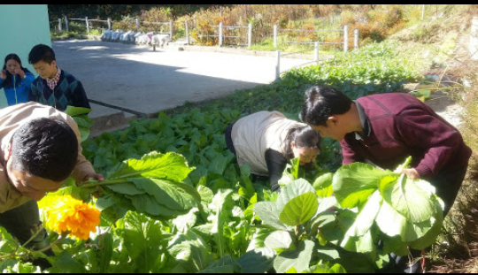
Harvesting from mdm nutrition garden

Slide 23
STUDENTS WITH GARDENING TOOLS

Slide 24
Students watering tomatoes in poly house

Slide 26
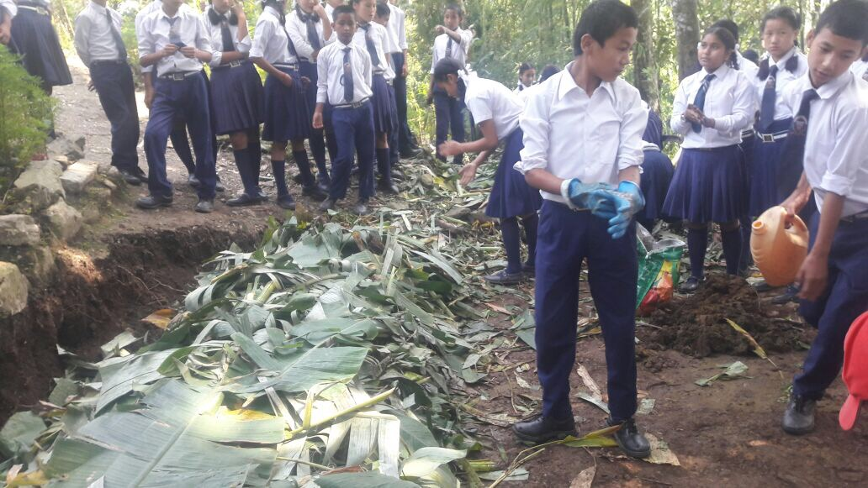
PREPARATION OF COMPOST PIT

Slide 27
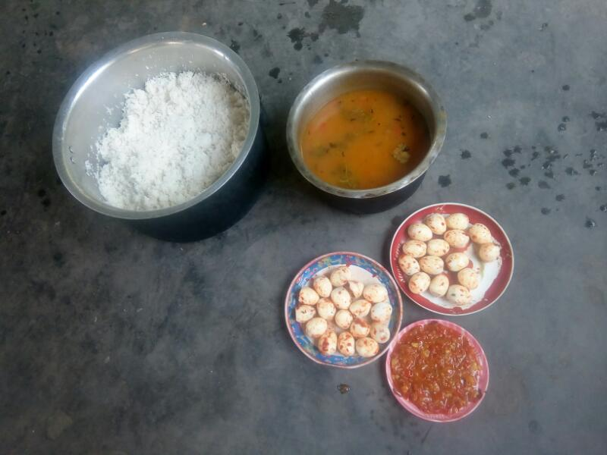
Serving eggs in MDM

Slide 28
MULTI TAP FACILITIES

Slide 29
Kitchen cum Dining sponsored by Local]

Slide 30
Dining & kitchen of Maniram SS constructed by local agencies.

Slide 31
Training at District level
Stake holders
School Heads/MDM Tr.

Slide 32
Meeting with distt I/C
Quality checking of rice at FCI godown

Slide 33
MDM sensitization at District level
Teachers Involves in MDM

Slide 34
TRANING OF CCH. AT DISTRICT LEVEL.

Slide 35
Foodgrains distribution during lockdown period:- 17.3.2020 till 30.5.2020
Package of rice
Police on duty to maintain distance.

Slide 36
Distribution of rice by maintaing social distancing by parents.

Slide 38
THANK YOU

